Slide 1
Interpreting Signals in the Labor Market: Evidence from Medical Referrals
By: Heather Sarsons
Presentation: Paul George
Date: 9/28/22

Slide 2
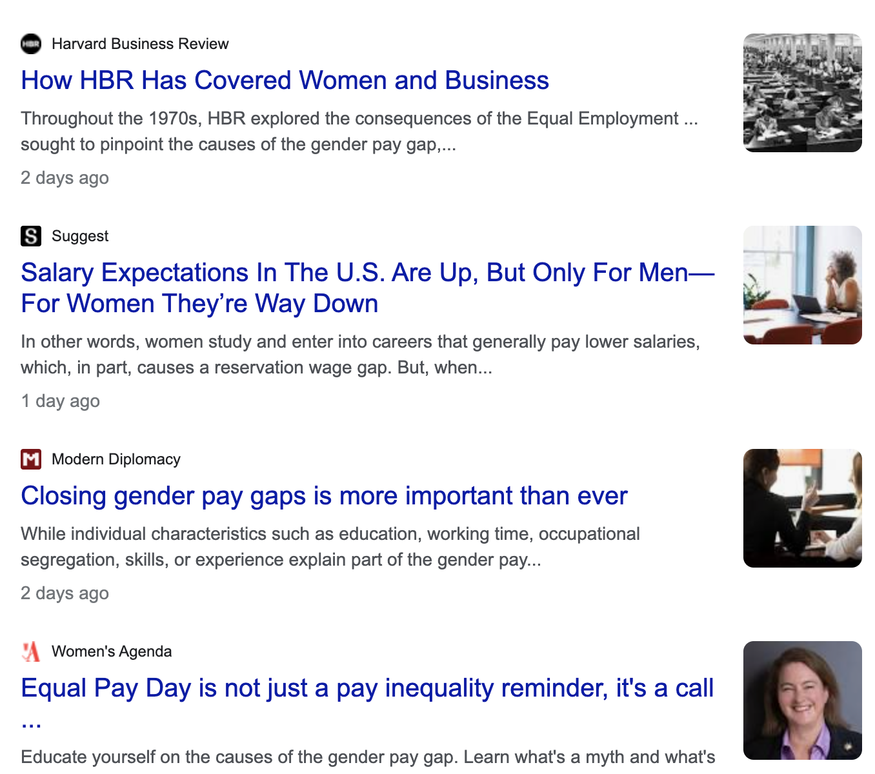
Motivation
Notes:
I find this study to be super interesting, because for me, it’s a new way to look at health economics. Instead of the more straightforward way of using general economics principles to answer questions about the economics of healthcare, it’s using healthcare and healthcare markets as a laboratory to answer more general economics questions.
And they way health care is set up, it’s an industry that is more visible, has more publicly available information, and outcomes that are more easily comparable, than most other markets I think.

Slide 3
Research question
Does a surgeon’s gender influence how they are viewed and treated by other physicians?
Following a bad (or unexpectedly good) outcome on a surgical patient, do physicians change their referral patterns to the surgeon and, if so, is that change affected by the surgeon’s gender?
Notes:
Reminder, physician vs surgeon

Slide 4
Contribution
Large body of literature on gender gap, yet a large portion of the gap remains unexplained
Relatively little focuses on interpretation of signals of actual performance (as opposed to perceived performance), especially good/positive signals
Notes:
family commitments, individual preferences, personality, discrimination,

Slide 5
Preview of findings
Following a bad outcome (patient death):
Referrals drop more to female surgeons than to male surgeons
Following a good outcome (an unanticipated survival):
Referrals rise more to male surgeons than to female surgeons
Notes:
Top 1%ile (risk) of patient-surgery pair. (so, essentially has to be a sick patient + a risky surgery)
Male and female physicians seem to share in these referral biases equally
There is also a spillover effect

Slide 6
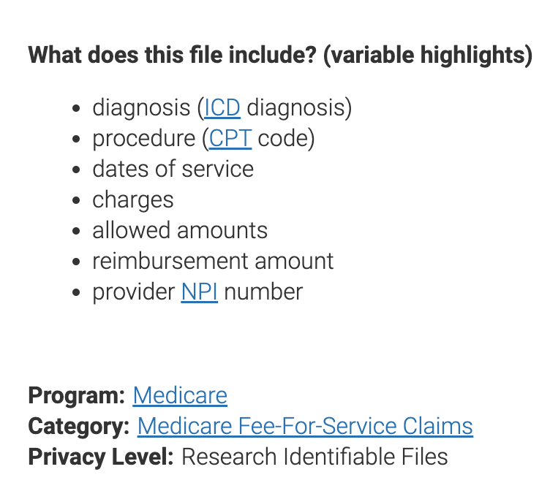
Data
Primary data source is Medicare Carrier file
20% random sample of fee-for-service claims of all Medicare beneficiaries (2008-2012)
Referral (physician-surgeon) dyad is the unit of analysis
Physician Compare National file
Dartmouth Atlas of Health Care
Notes:
Unit of analysis is the referring physician-surgeon
Physician compare national file – information on physicians/surgeons, including gender, specialty, experience
Dartmouth Atlas of Health Care is geographic dataset that matches physicians to their HRR (hospital referral region)

Slide 7
Matching procedure
Initial data sample:
265,000 physician-surgeon pairs with good events
302,000 physician-surgeon pairs with bad events
Match:
surgeon, physician, patient, procedure
Final sample for analysis
7,757 physician-surgeon pairs with good events
6,979 physician-surgeon pairs with bad events
?
Notes:
Match on surgeon specialty, procedure, patient gender/minority status (exact)
Coarse match on patients age, # of referrals before and after, surgeon experience
Coarse matching refers to a situation in which the populations are sorted into a finite number of classes and then randomly matched within these classes.

Slide 8
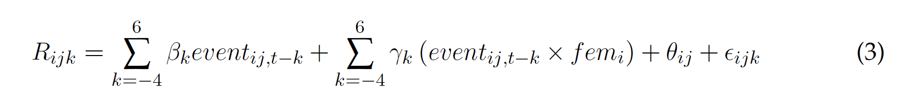
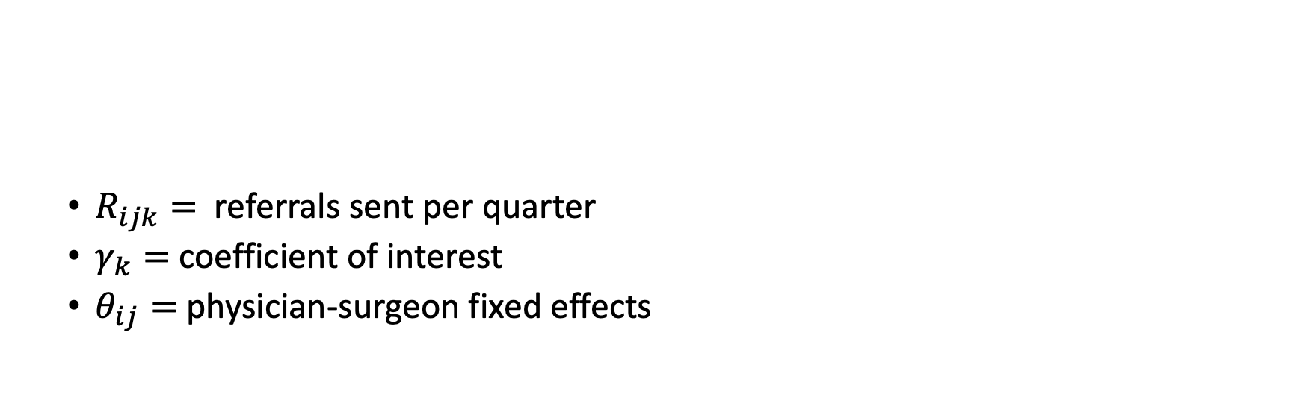
Event Study
$R_{ijk}=$ referrals sent per quarter
$γ_{k}=$ coefficient of interest
$θ_{ij}=$ physician-surgeon fixed effects
Why do the matching procedure? Why not just adjust for those variables in the estimating equation?
Notes:
Referrals physician J sends to surgeon i in quarter k
Gamma tells us how a physicians reaction to an event changes when the surgeon is a woman
Identifying assumption = women do not systematically receive different types of patients or perform different procedures than man
Matching on patient characteristics, including patient risk, as well as on the procedure code, helps keep this assumption true

Slide 9
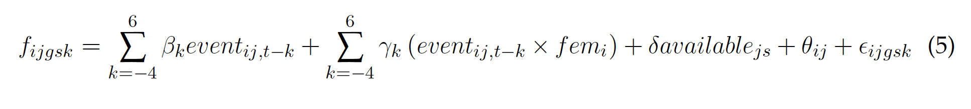
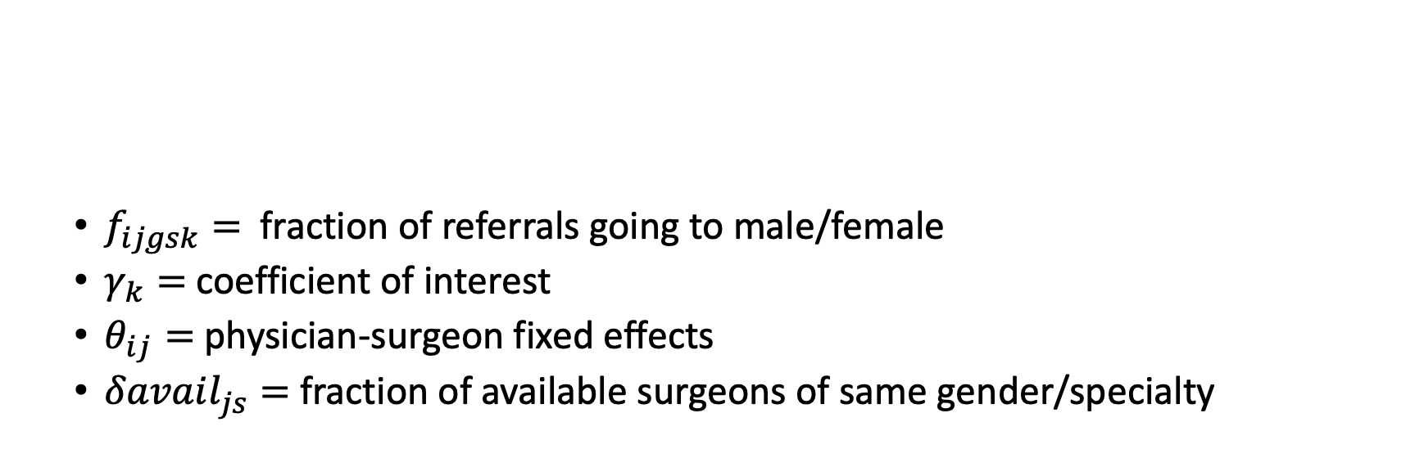
Event Study – Spillover effect
$f_{ijgsk}=$ fraction of referrals going to male/female
$γ_{k}=$ coefficient of interest
$θ_{ij}=$ physician-surgeon fixed effects
$δavail_{js}=$ fraction of available surgeons of same gender/specialty
Notes:
Avail ensures the results are not driven by constraints in referral options

Slide 10
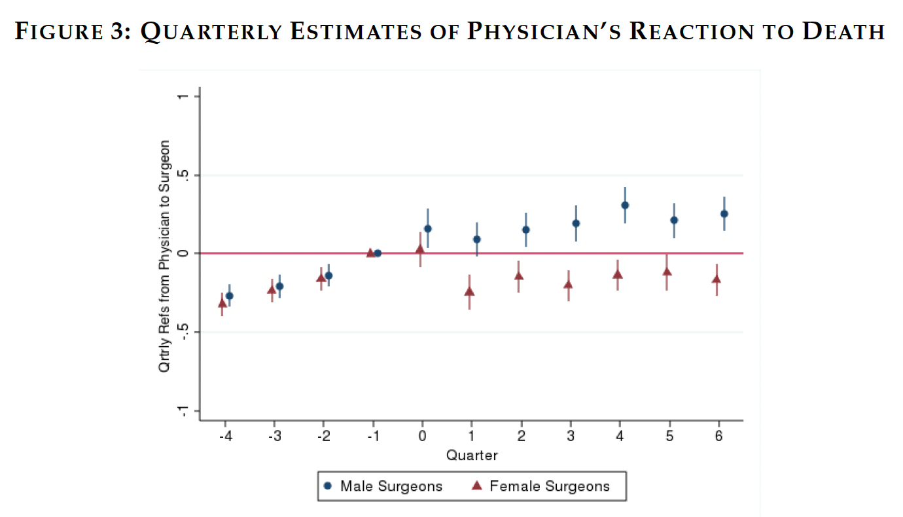
Why is there an increasing trend prior to the event (quarter 0)?
Notes:
Makes sense that there would be an increasing trend – no event means patient did OK, so physician would keep referring to the surgeon.

Slide 11
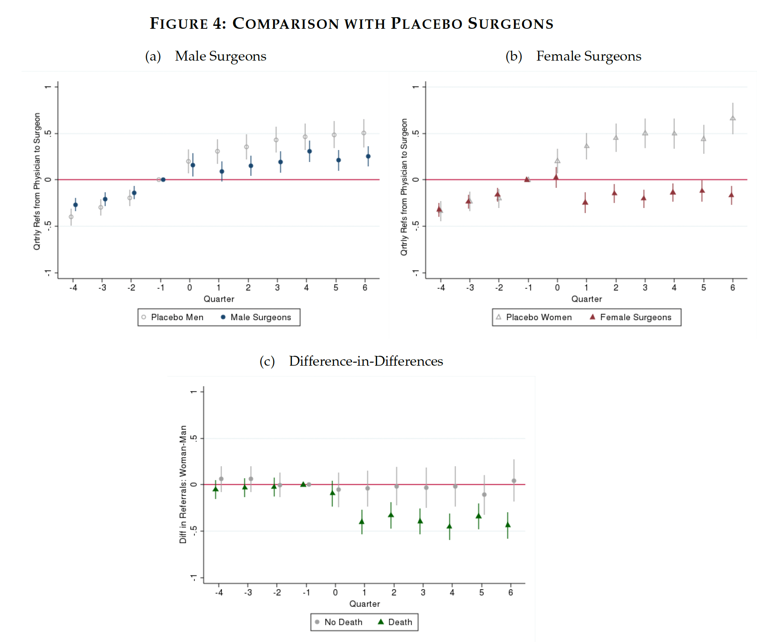
Notes:
I like this placebo surgeon, because it’s a way of testing the parallel trends assumption

Slide 12
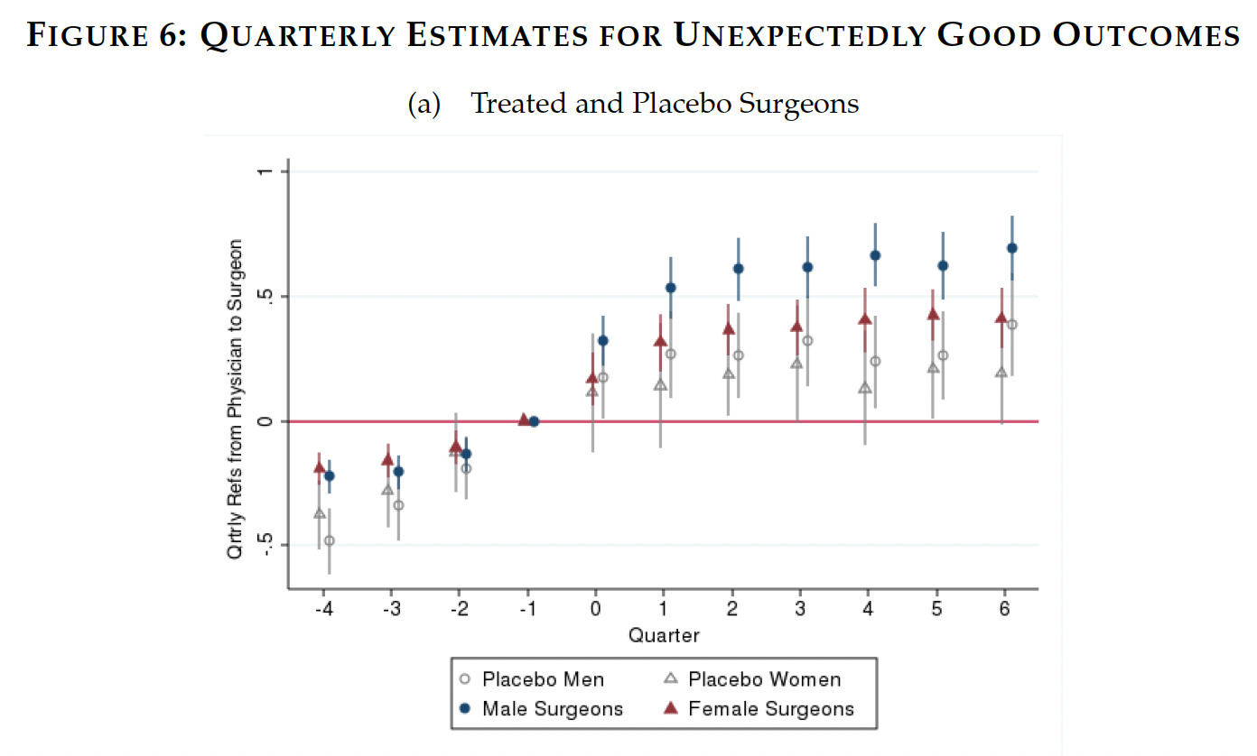

Slide 13
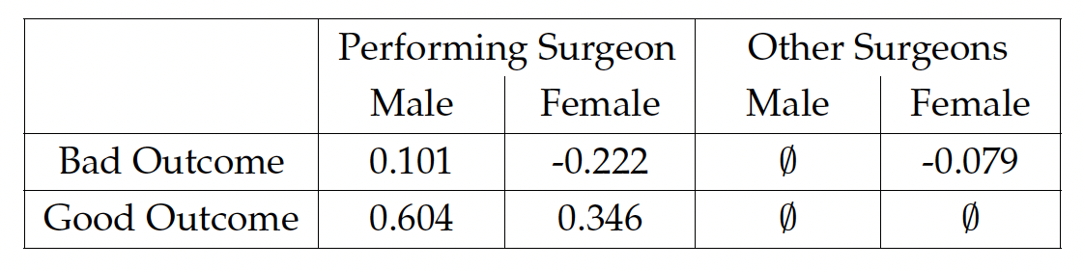
Summary of Main Findings

Slide 14
Limitations/Threats
Are male surgeon’s patients riskier in unobservables?
Would have to be 70pp riskier to account for difference
Who is actually making the choice about referrals (in the physician’s office)?
There could be factors outside of the hospital/healthcare system not seen in the data that account for difference in referrals
For example, are male physicians and male surgeons more likely to be friends/have a relationship outside of work?
Are female physicians more likely to move than male physicians?
Patient preference unaccounted for
Why is this only a working paper?

Slide 15
Other directions
How does surgeon race/ethnicity affect referrals?
How do surgeon’s referrals to other surgeons change following a bad outcome?
Does having ‘insider knowledge’ of the job affect these biases?
How else is the healthcare system like a laboratory, where available information can be extrapolated elsewhere?

Slide 16
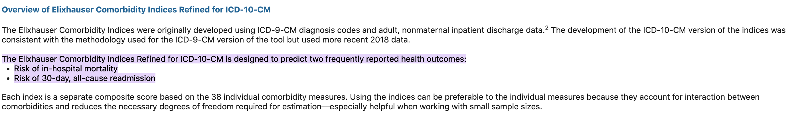
Miscellaneous notes

